Slide 1


Towards Practical Few-shot Federated NLP
Dongqi Cai¹, Yaozong Wu¹, Haitao Yuan¹,
Shangguang Wang¹, Felix Xiaozhu Lin², Mengwei Xu¹
Beiyou Shenzhen Institude¹
University of Virginia²
The 3rd Workshop on Machine Learning and Systems, co-located with EuroSys 2023.
Notes:
Hello everyone, welcome to EuromlSys twenty twenty-three. My name is Dongqi Cai, and I am here to present our work on "Towards Practical Few-Shot Federated NLP." The work is advised by Professor Mengweixu, Shangguangwang from Beiyou Shenzhen Institute, and Felix Xiaozhu Lin from the University of Virginia.
---
Hello, everyone, welcome to euromlsys twenty twenty three. I am dongqi cai. I am going to present our work “towards practical few-shot federated nlp”. It is adviced by professor mengweixu, shangguangwang from beiyou Shenzhen institude and felix xiaozhu lin from university of virginia.

Slide 2
Background
Few-shot Federated Natural Language Processing (NLP)
Notes:
Let me start by introducing the background of our work.
--
First , I will introduce the background of our work, that is fed-shot federated natural language processing.

Slide 3


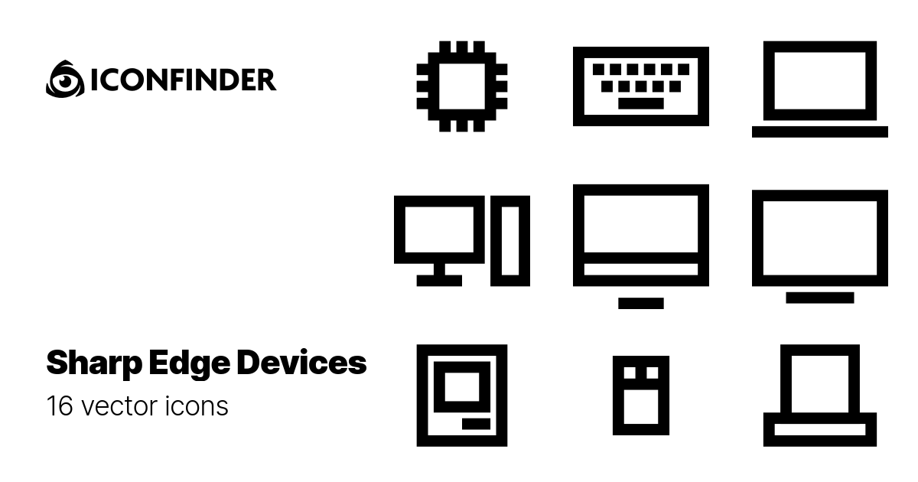
Federated NLP (FedNLP) [1]
Text Clssification.
Fine-tuning
BERT, DistilBERT, BART, GPT, etc
Seq. Tagging
Fine-tuning
Deployment
Pre-training
…
…
Fine-tuning
Text Generation.
…
Private, geo-distributed
Labeled
Public, centralized
Cloud
Cloud&Clients
Clients
[1] Dongqi Cai, Yaozong Wu, Shangguang Wang, Felix Xiaozhu Lin, and Mengwei Xu. Autofednlp: An efficient fednlp framework. arXiv preprint arXiv:2205.10162, 2022.
Notes:
--polished—
The development of pre-trained models has been overwhelming, especially with the rise of transformers and their variants such as BERT, GPT, and so on.
The deployment of these models commonly involves a two-step training process: pre-training and fine-tuning.
Unlike self-supervised pre-training, fine-tuning is supervised, requiring a tremendous amount of data specific to the task. However, the exploitation (| ˌɛksplɔɪˈteɪʃn |) of private user data is restricted and even prohibited in some cases.
Recently, federated learning has become the de-facto approach for training models with privacy preserved. However, most work assumes that all training samples on clients are labeled, which is often not the case in real-world scenarios where labeled data is scarce.
--DQ’s--
The development of pre-trained models is overwhelming with the rise of transformers and its varients for example bert, gpt etc. [1]. Their deployment [2–6] is commonly composed of two-step training: pretraining and fine-tuning.
First, The pre-training phase initializes a model on large text corpora. The training is self-supervised and time-consuming, often taking hundreds of GPU days [14, 20]. Pre-training teaches the model a language’s inherent structure, e.g. word distribution.
Then, the fine-tuning phase further adapts a pre-trained model for a specific NLP task targeting a specific domain, e.g. to classify sentiments (a task) of user emails (a domain) [20].
Finally, the finetuned model is deployed into clients device after light-weight optimization like quantization.
Unlike self-supervised pre-training, fine-tuning is supervised, requiring task-specific tremendous labeled data. However, the exploitation of private user data is restricted and even prohibited in some cases by several data protection regulations such as GDPR [7] and CCPA [8].
Recently, federate learning (FL) [9, 10] becomes the de-facto approach to train a model with privacy preserved. And there have been several work dealing with training NLP models in a federated setting, It is referred to as federated NLP or FedNLP.
Most of them assume all training samples on clients are labeled, however, the labeled ones are often scarce in real-world scenarios.

Slide 4


Federated Few-shot Learning (FedFSL)
Challenges:
1. Lack of labels
2. Error pseudo-label hurts
Solutions:
1. Pseudo labeling
2. Prompt learning
Our system:
AUG-FedPrompt
Cloud Aggregator
Data with gold labels
Data without labels
Data with pseudo labels
Weights
Local Model
Weights
…
…
…
…
…
…
Trainer
Trainer
&
Labeler
(a) Conventional Federated Learning
(b) Our FedFSL Scenario
Notes:
This is because each sample is accessible to only one client user who can label it, and most users are reluctant to label their data. Moreover, data labeling for certain NLP tasks requires domain-specific knowledge that most users do not possess, leading to mislabeled data that can mislead the training.
So, we assume a key obstacle to practical Federated NLP is the lack of labeled data, which we refer to as Federated Few-Shot Learning.
Apart from the lack of labels, those surviving labels could be skewed distributed in few clients because only part of clients are willing or knowledgeable to label their data for training.
To tackle this challenge, we introduce pseudo labels, the popular method in central self-supervised learning.
After receiving an aggregated model from the server, a mobile client may run inference on all its unlabeled data for pseudo labeling. With pseudo-labeling, all trainers in federated learning could be the data labelers of themselves.
However, the pseudo-labels generated by weak models are prone to errors and may hurt the training instead of helping. To address this issue, we introduce prompt learning, a powerful NLP technique that adds task description for NLP tasks, commonly used in few-shot NLP scenarios.
Based on these two techniques, we propose Augmented FedPrompt, a prompt-based federated learning system that exploits abundant unlabeled data for data augmentation. Our experiments indicate that our system can perform on par with full-set fine-tuning with only a limited amount of labeled data.
---
Because Each sample is accessible to only one client user who can label it. Reports show that most users are reluctant to label their data [21, 82]. This is fundamentally different from traditional centralized or crowdsourced data labeling services that can recruit highly specialized data labelers [42].
Data labeling for certain NLP tasks require domian-specific knowledge, which most users do not possess. In some case, they might even mislabel and mislead the training.
A key obstacle to practical Fedederated NLP is lack of labels. We refer it as federated few-shot learning.
Apart from the lack of labels, those surviving labels could be skewed distributed in few clients because only part of clients are willing or knowledgeable to label their data for training.
To tackle this challenge, we introduce pseudo labels, the popular method in central self-supervised learning.
After receiving an aggregated model from the server, a mobile client may run inference on all its unlabeled data for pseudo labeling.
Integrated with pseudo labeling, all trainers in federated learning could be the data labelers of themselves.
The second challenge is pseudo labels generated by weak models are prone to be error and will hurt the training instead of helping.
So we further introduce prompt learning, a powerful NLP technique that add task description for NLP tasks, so as to boost accuracy in model fine-tuning, which is commonly used in few-shot NLP scenarios.
Based on those two techniques, we propose augmented fedprompt, a prompt-based federated learning system that exploits abundant unlabeled data for data augmentation. Our experiments indicate that augmented fedprompt can perform on par with full-set fine-tuning with a limited amount of labeled data.
---
As a result,
(4). Mislabels are not uncommon.
Unexplored: fine-tuning is often few-shot. While training samples on clients can be abundant, the labeled ones are often scarce. To exacerbate the problem, the numbers of labels could vary drastically across clients. Such skewed label distribution, combined with the non-IID data distribution nature in FL (e.g., skewed class distribution [43, 86]), could further degrade the fine-tuning accuracy. The causes for label scarcity are fundamental. • Users lack willingness. Each sample is accessible to only one client user who can label it. Reports show that most users are reluctant to label their data [21, 82]. This is fundamentally different from traditional centralized or crowd-sourced data labeling services that can recruit highly specialized data labelers [42]. • Users lack expertise. Data labeling for certain NLP tasks require domian-specific knowledge, which most users do not possess, e.g., cross-lingual transfer [54], Q&A [84], or biomedical text corpora understanding [94]. • Diverse NLP tasks. Downstream tasks are emerging over time, e.g., new domains, topics, or data distributions. Asking users to label a large amount of data for each task is tedious, inefficient, and impractical. • Mislabels are not uncommon. Mislabels are common in real world, e.g., 6% in the well-established ImageNet or even more than 10% in other crowd-sourced datasets [51]. In FedFSL, since the labels from end users are merely impossible to be verified, we expect an even higher ratio of mislabels, which can significantly harm the model quality. Instead, trainers might only use the labels from very few, highly trustworthy people. In essence, we argue that few-shot is a more realistic way to depict NLP training, a scenario we call as FedFSL. Unfortunately, FedFSL, in particular its system implications, are rarely investigated – in comparison, prior FL literature assume abundant data labels (at least hundreds of thousands) uniformly distributed across clients.

Slide 5
Problem setup
Data generator and preliminary experiments
Notes:
Now I am going to go deeper in our system. To begin with, I’ll present our data generator and some preliminary experiments.

Slide 6


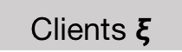

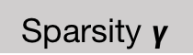

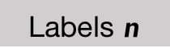

Problem setup
We propose a data generator to simulate federated few-shot dataset.
NLP Dataset
Yahoo[1]
Data generator
Labels $n$
$$1024$$
$$z∼{Dir}_{ξ}⁡(γ)$$
$$\left|𝒯_{i}\right|=z_{i}n$$
Sparsity $γ$
$$10^{x}$$
Labeled data
Distribution
Clients $ξ$
$$32$$
Federated NLP
Few-shot Dataset
[1]. Xiang Zhang, Junbo Zhao, and Yann LeCun, “Character-level convolutional networks for text classification,” Advances in neural information processing systems, vol. 28, 2015.
Notes:
To tackle the issue of insufficient and skewed labeled data, we designed a comprehensive data generator containing three meta-parameters: label quantity "n" and its sparsity "gamma", and client number with those labels as ”ksi". It covers most, if not all, potential scenarios for practical few-shot FedNLP.
For example, we visualize the labeled data skewness on Yahoo. When "gamma" is small, the labeled data will be skewed distributed, i.e., only a few clients own labeled data; when "gamma" is large, labeled data is nearly uniformly distributed on all clients.
---
To address the issue of insufficient and skewed labeled data, we design a comprehensive data generator as the first step towards simulating the distribution of labeled data for few-shot FedNLP tasks. The generator has three metaparameters: label quantity n and its sparsity gamma, and client number with those labels as \xi(ksi). It covers most, if not all, potential scenarios for practical few-shot FedNLP.
For example, we visualize the labeled data skewness on Yahoo with a label quantity as one thousand twenty four and a client number as thirty two.
Each sub-figure represents a 32 by 10 matrix, the intensity of which represents the labeled samples of a particular label. When gamma is small, the labeled data will be skewed distributed, i.e., only few clients own labeled data; when gamma is large, for example gamma equals one hundred, labeled data is nearly uniformly distributed on all clients.
首先建模问题

Slide 7
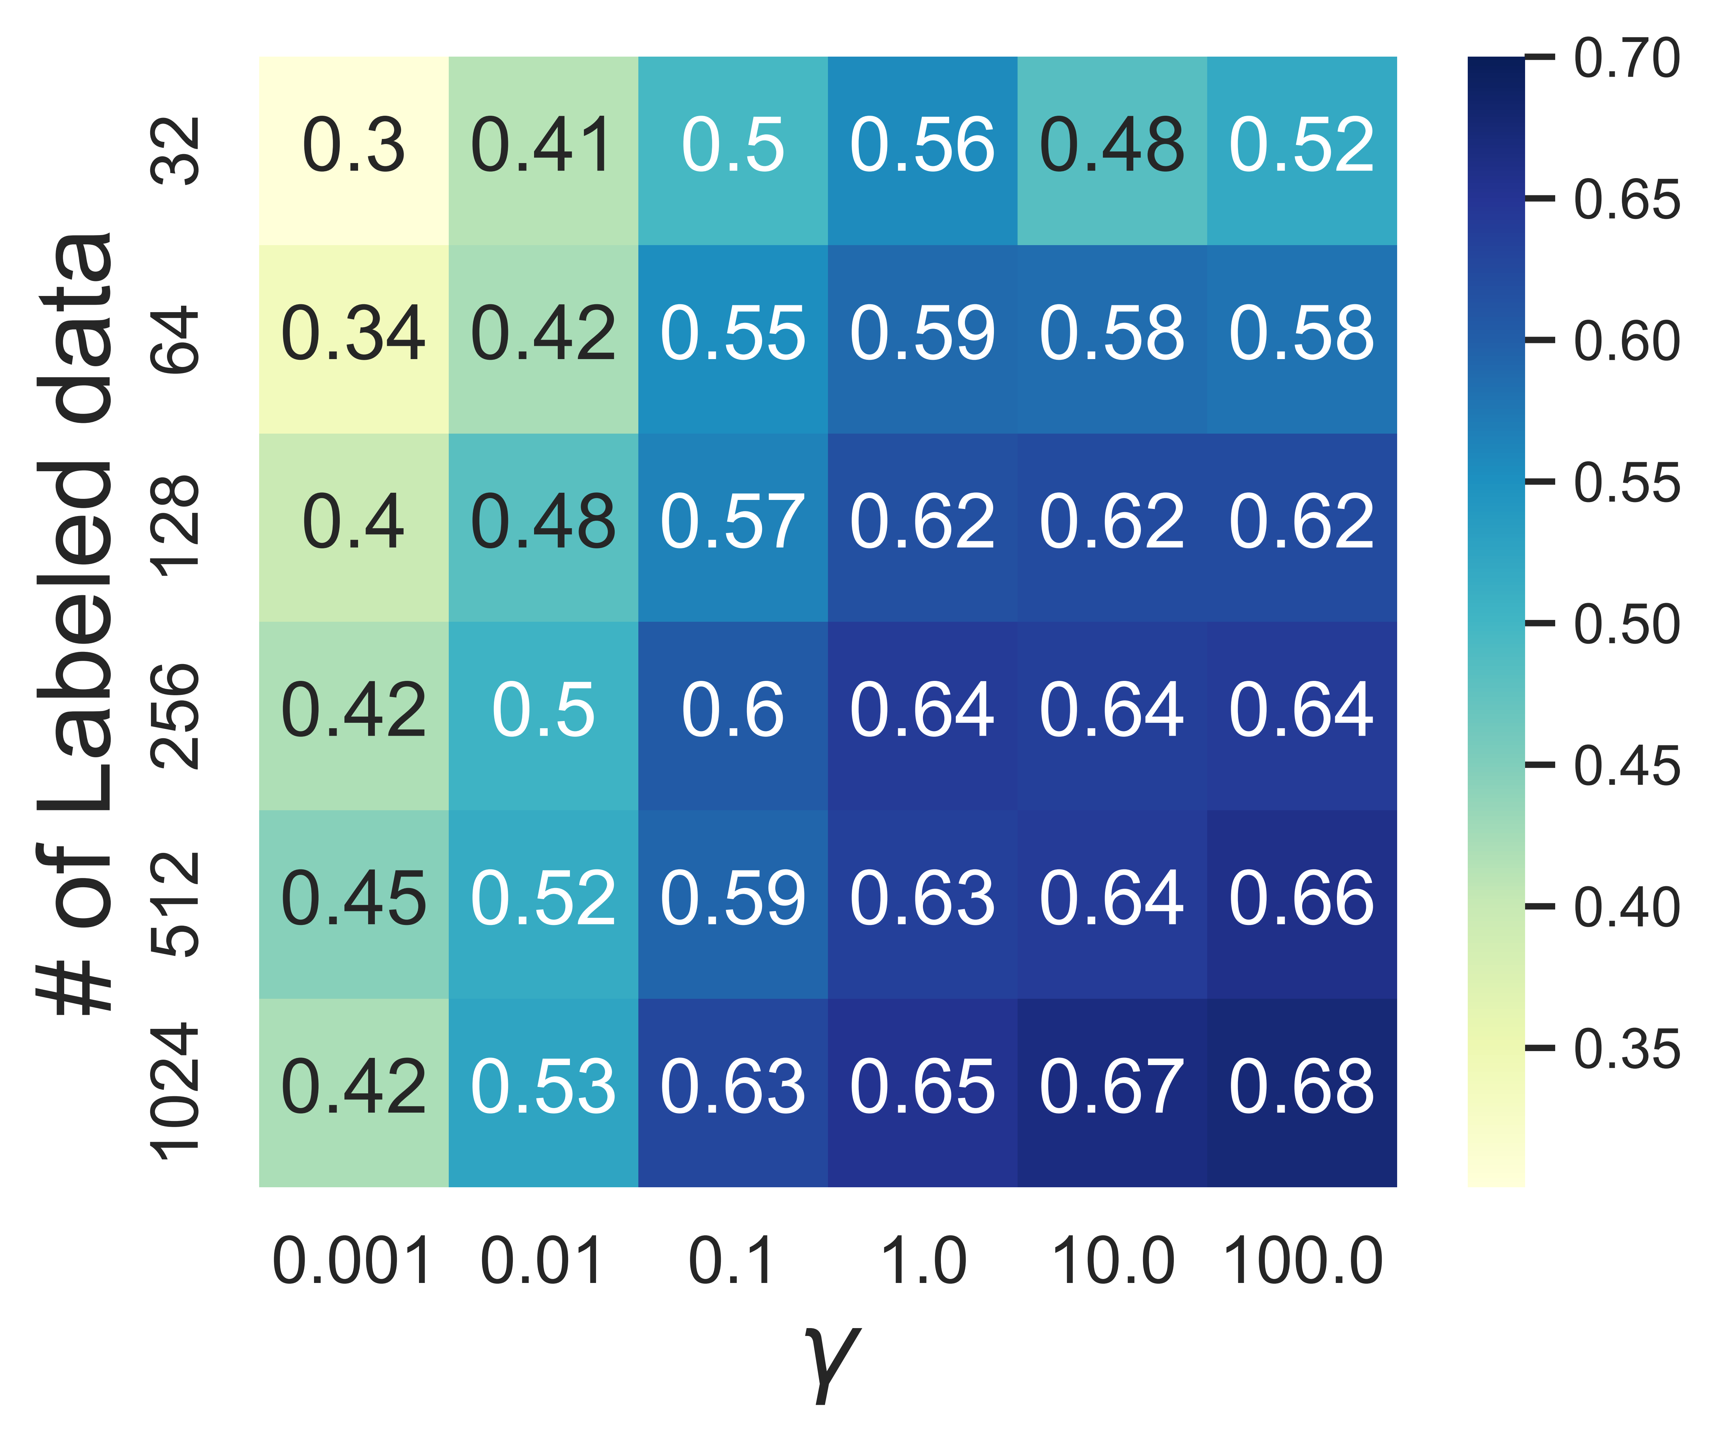
FedFSL Performance degradation
More labeled data (n = 1024) will be 19% better than lack of labels (n = 32).
Uniform distribution (𝛾 = 100) will be 26% better than skewed distribution (𝛾 = 0.001).
Conclusion:
Lack and skewness of labels will degrade performance.
Notes:
Based on our data generator, we have analyzed the impact of insufficient labels and label skewness on federated few-shot learning.
Intuitively, we can see that having more labeled data greatly improves the performance of federated NLP.
Furthermore, we have observed that as the labeled data becomes more skewed, the convergence performance of the model degrades.
In conclusion, lack and skewness of labels have a negative impact on performance in federated few-shot learning, which validate our practical assumption.
---
Based on the data generator , we present the impact of lack of label and label skewness on federated few-shot learning.
Intuitively， more labeled data would do a great help for federated nlp performance, n = 1024 will be 19% better than n = 32.
Besides, we observe that as gamma decreases,that is, the labeled data becomes more skewed, the convergence performance of the model degrades
For example, when labeled data points are one thousand twenty four, uniform distribution will be 26% better than skewed distribution. The rationale behind this phenomenon is that the aggregated model may favor certain labels possessed by clients with training data.
In a word, Lack and skewness of labels will degrade performance.

Slide 8
Our System: AUG-FedPrompt
Two key building blocks: Pseudo labeling and Prompt Learning
Notes:
We propose the "augmented FedPrompt" as a solution to address the challenges.
---
We propose augmented fedprompt as a solution to address the challenges posed by lack and skewness of labels without sharing data.

Slide 9



System Design
AUG-FedPrompt
Description: A prompt-based federated learning system that exploits abundant unlabeled data for data augmentation.
Data generator
Pseudo labeling
Prompt Learning
$$z∼{Dir}_{ξ}⁡(γ)$$
$$\text{Lack} \text{and} \text{skewness} \text{of} \text{labels}\text{.}$$
$$\text{Improve} \text{the} \text{quality} \text{of} \text{pseudo} \text{labels}\text{.}$$
$$\left|𝒯_{i}\right|=z_{i}n$$
Output: Competitive performance under various federated few-shot learning settings, requiring less than 0.1% data to be manually labeled.
Notes:
Our system AUG-FedPrompt, which stands for augmented FedPrompt, is a prompt-based federated learning system.
It leverages large amounts of unlabeled data via the federated orchestration (okistrating) of pseudo labeling and prompt learning.
Remarkably, under various federated few-shot learning settings, augmented FedPrompt performs on par with the full-set method, while requiring less than zero point one percent of the data to be manually labeled.

Slide 10
Pseudo labeling
The rational behind pseudo labeling:
“Training with pseudo labels encourages the model to learn a decision boundary that lies in a region where the example density is lower. ”
Data without labels
Data with pseudo labels
Local Model
For example,
“great”:0.9, “bad”:0.1 rather than “great”:0.6, “bad”:0.4
Low class overlap Low entropy
Notes:
First, let me introduce pseudo labeling.
During model training, the trainer uses the current model to infer on unlabeled data and considers the resulting inference results as if they were true labels for subsequent training. This method, also known as soft labeling, has been shown to be effective both empirically and theoretically.
The idea behind it, is that training with pseudo labels encourages the model to learn a decision boundary that lies in a region where the example density is lower. This decision boundary typically leads to good generalization performance, even though the true labels of individual samples remain unknown.
For example, the resultant model assigns a high probability zero point nine to positive label "great" rather than a lower probability zero point six, which in turn encourages low entropy.

Slide 11
Prompt learning
■ T1 (label = +1): “Most delicious pizza I’ve ever had.”
■ T2 (label = -1): “You can get better sushi for half the price.”
■ T3 (label = ?): Pizza was good. Not worth the price.
Prompt
"It was <MASK>. Pizza was good..."
It was <MASK>.
Pizza was good..."
Forward
Backward
Input Text
Pizza was good…
+1
Pre-trained Model
Fine-tuned Model
Loss
Label
+1: 0.8
great: 0.8
-1: 0.2
terrible: 0.2
Notes:
The second technique we utilize is prompt learning, a powerful NLP technique that improves the accuracy of model fine-tuning, commonly used in few-shot scenarios. For Federated Few-shot learning, we find prompts to be crucial in the early stages of training, when the model is weak and can barely generate useful pseudo labels.
Briefly, Let's suppose we fine-tune a foundation model to classify restaurant reviews and are given only two labeled samples.
The first sample is "Most delicious pizza I’ve ever had." and is positively labeled, while the second sample "Pizza was good. Not worth the price." is negatively labeled.
With such a small number of labeled samples, training a usable classification layer is impossible.
Consider an unlabeled example:
“Pizza was good. Not worth the price.”
The model may positively predict the unlabeled example’s class if the task is to classify user satisfaction, or negatively if the task is about whether price is mentioned. But without such a task description, the model can only randomly guess and generate an error pseudo label.
To fix the problem, the insight of prompt learning is that the foundation model already encodes knowledge for performing various tasks; it just needs a prompt that describes what the task is.
More formally, a cloze question is called a pattern and the mapping from words to classes is done by a verbalizer.
The training loss is the cross-entropy between the correct answer and the distribution of probabilities among the tokens in the verbalizer.
---
Second technique is prompt learning. It’s a powerful NLP technique that boosts accuracy in model fine-tuning, which is commonly used in few-shot scenarios.
For Federated Few-shot learning, we find prompts crucial to the early stage of a training sessions, when the model is weak and can barely generate useful pseudo labels
For example, suppose we fine-tune a foundation model to classify restaurant reviews and are only given two labeled samples.
First sample: “Most delicious pizza I’ve ever had.”is positively labeled. While the second sample “Most delicious pizza I’ve ever had.”is negatively labeled.
With such few samples, training a usable classification layer is impossible. Consider an unlabeled example:
“Pizza was good. Not worth the price.”
The model may positive predict the unlabeled example’s class probabilities if the task is to classify user satisfaction, or negatively if the task is about whether price is mentioned. But without such a task description, the model can only randomly guess and generate an error-prone pseudo label.
To fix the problem, the insight of prompt learning is that the foundation model already encodes knowledge for performing various tasks; it just needs a prompt that describes what the task is.
The cloze-style phrases is exactly what the foundation model was pre-trained for, that is to predict missing words in text.
More formally, a cloze question is called a pattern and the mapping from words to classes is done by a verbalizer.
The training loss is the cross-entropy between the correct answer and the distribution of probabilities among the tokens in the verbalizer.
---
With such few samples, training a usable classification layer is impossible. Consider an unlabeled example:
In the example above, if ML developers augment all samples with a leading prompt, e.g. T3 becomes:

Slide 12
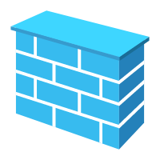

Workflow
Pseudo-labeled Data
Labeled Data
Unlabeled Data
Next Iteration
…
…
…
…
…
Aggregated model
…
…
Clients
Pseudo Labeling
…
…
…
…
…
…
It was <MASK>.
Pizza was good..."
Forward
Backward
Input Text
Pizza was good…
+1
Pre-trained Model
Fine-tuned Model
Loss
Label
+1: 0.8
great: 0.8
Local Prompt Training
-1: 0.2
terrible: 0.8
Notes:
Here is our system workflow orchestrating (/ˈɔːrkɪstreɪtɪŋ/) pseudo labeling and prompt learning.
Firstly, clients with labeled training data conduct local prompt learning without sharing their data. This approach enables them to fine-tune their models for the task at hand.
The clients then send their fine-tuned models to the cloud for federated average aggregating.
The aggregated model is distributed to all clients, even those who did not participate in the last round of training and do not have labeled data.
These clients can leverage the received model to do pseudo labeling on their unlabeled data. They add the data with the highest confidence as training samples for next iteration.
--
Here is our system orchestrating (/ˈɔːrkɪstreɪtɪŋ/) pseudo labeling and prompt learning.
First, each client having labeled training data do local training via prompt learning without sharing data.
Then they send the fine-tuned models to the cloud for federated average aggregating.
The aggregated model is sent back to all clients, even they do not attend last round training, that is, they do not have training labels though.
Clients leverage the received model to do pseudo labeling on all their unlabeled data. The data with the highest confidence are added as training samples.
In subsequent training rounds, pseudo labels are treated equally as the manually annotated labels.
---
FedPET for real-world few shot text classification.
AUG-FedPrompt: Prompt-Based FedNLP together with Unlabeled Data Augmentation
把prompt 和 unlabeled data

Slide 13
Experiments
Convergence performance and system cost
Notes:
Now, let's take a look at the experimental results.
--
Now let’s see the experiment results.

Slide 14
Experiment setup
Server | Edge device
a GPU server with 8x NVIDIA A40. | Jetson TX2, 256-core NVIDIA Pascal™ GPU.
Notes:
We evaluated our system on four English datasets using manually designed prompts. Our experiments were conducted on a GPU server. The on-device training time was measured using a developing board.
To minimize variance, each experiment was repeated three times.
---
We perform our evaluation on four English datasets and manually designed prompts2 ,
our experiments are carried out in an emulation manner on a GPU server with 8x NVIDIA A40. The on-device training time is obtained on the development boards NVIDIA TX2, which has similar hardware capacity to mainstream mobile devices.
We run every experiment 3 times in order to reduce variance.
---
Batch size: 4;
Local training iteration: 1;
Learning rate: 10⁻⁵;
Max sequence length: 256;
Clients per round: 5;
For pseudo labeling, we filter out those aggregated models performing worse than the zero-shot model and those pseudo-labeled data with confidence lower than 0.9.
For the FL configurations at the server side, we follow the prior FedNLP literature [11, 12] to select 5 participants for each training round by default. The fine-tuned models will be collected in the central server and aggregated through FedAvg algorithm [9].

Slide 15
Performance across data scales
AUG-FedPrompt enjoys up to 50%, 25%, 55%, 38% accuracy improvement separately for 4 datasets.
For a usable accuracy, AUG-FedPrompt saves up to 99.9% training data compared to full-set federated finetuning.
Notes:
To begin with, we conducted experiments to demonstrate the convergence performance of our system across different data scales.
As illustrated in the figure, the blue line represents the baseline, vanilla federated fine-tuning method, whereas the dotted line indicates the upper bound obtained by fine-tuning with all labeled training data. The highlighted region showcases the accuracy gap between our system and the baseline.
Our augmented FedPrompt outperforms the baseline on each task, achieving accuracy improvements of up to fifty-five percent.
Furthermore, to attain an usable accuracy, that is ninety percent relative to the full-set training accuracy, our system requires only hundreds of labeled. This represents significant savings of up to ninety-nine point nine percent compared to full-set federated fine-tuning.
---
First, we do experiments to show system convergence performance across data scales.
As shown in Figure, blue line is the baseline federated fine-tuning method. The dot line shows the upper bound, in other words, fine-tuning with all training data labeled.
Highlighted region shows the accuracy gap between our system and baseline.
Our augmented FedPrompt enjoys a substantial advantage on each task.
There are up to 50%, 25%, 55%, 38% accuracy improvement separately for 4 datasets. Both approaches improve with more labeled data, but AUG-FedPrompt remains better by a varying amount.
For a usable accuracy, i.e., 90% relative performance of full-set training accuracy, AUG-FedPrompt only needs 64, 256, 256 in total for AGNEWS, YAHOO and YELP-F, saving up to 99.9% training data compared to full-set federated fine-tuning.

Slide 16
Impact of Data Augmentation
AUG-FedPrompt shows competitive performance under various federated few-shot learning settings, regardless of uniform or skewed label distribution.
Up to 95.3% of unlabeled data is pseudo-labeled correctly at the convergence round.
Notes:
Next, we conducted ablation experiments to show the impact of pseudo-labeling.
As shown in the table, FedPrompt - our system without data augmentation - delivers competitive performance when labeled data is uniformly distributed across clients. However, when labeled data is unevenly distributed across clients, FedPrompt's performance significantly drops.
In contrast, the augmented FedPrompt system, with pseudo-labeling, performs strongly under various federated few-shot learning settings, regardless of whether the label distribution is uniform or skewed.
Moreover, prompt learning improves the accuracy of early-stage data labeling. As training goes on, the inference accuracy continues to increase, reaching ninety-five percent at the convergence round.
---
Then we do ablation experiments to show the impact of peseudo labeling.
As shown in Table 2, FedPrompt, i.e., our system without data augment shows competitive performance when labeled data is uniformly distributed on clients. While skewed distribution of labeled data will hurt FedPrompt performance significantly. For example, FedPrompt performance degrades to 41.8% on YHAOO when 256 labeled data is skewed distributed on 32 clients.
With pseudo labeling, augmented FedPrompt shows competitive performance under various federated few-shot learning settings, regardless of uniform or skewed label distribution.
Besides, prompt learning helps to label more data correctly at the early stage of training. In the first three rounds, the average ratio of correctly labeled data by pseudo-labeling on unlabeled data is 92.5%. The inference accuracy will further increase along with the FL training moves on, reaching 95.3% at the convergence round.
---
AUG-FedPrompt shows competitive performance under various federated few-shot learning settings, regardless of uniform or skewed label distribution

Slide 17
System cost analysis
AUG-FedPrompt prefers large language models.
Finetuning these ‘behemoths’ can be extremely resource-intensive.
Future work
Notes:
While the combination of pseudo-labeling and prompt learning has shown promising few-shot performance, it comes at a non-trivial system cost.
First, we conduct experiments to show that large models can help augment the few-shot learning abilities of augmented FedPrompt.
For example, RoBERTa-large outperforms all other models across all four datasets.
However, fine-tuning these big models can be extremely resource-intensive. Even on our powerful GPU-embedded edge device, training RoBERTa-large leads to long latency, about eight seconds per batch.
Note that our batch size is only 4.
Additionally, during training, our testbed device, which only has eight GBs of RAM, ran out of memory.
Fortunately, many optimization solutions have been proposed to fine-tune large models efficiently. Our future work will focus on developing an optimized system solution for augmented FedPrompt to enhance its resource efficiency.
--
However, there is no free lunch for the performance improvement of AUGmented FedPrompt.
The orchestrating of pseudo labeling and prompt learning results in promising few-shot performance, but it also incurs a non-trivial system cost.
First, we do experiments to show that large models can help augment the few-shot learning abilities of augmented FedPrompt.
For example, RoBERTa-large outperforms all other models across all four datasets, particularly MNLI and YELP-F, where it shows up to 38.2% improvement than others.
But finetuning these ‘behemoths’ can be extremely resource-intensive. even on a powerful GPU-embedded edge device like NVIDIA TX2, training RoBERTa-large leads to long latency (about 8.1s per batch). Moreover, during training, our testbed device, which has only 8GB of RAM, ran out of memory during training.
Fortunately, lots of optimization solutions have been proposed to fine-tuning large models efficiently, that will be our future work to develop an optimized system solution for AUGmented FedPrompt to enhance its resource efficiency.

Slide 18
Takeaway
Target: Data labels can be scarce and skewed in federated learning.
Contribution:
Data generator for federated few-shot learning task.
The lack and skewness of labeled data can significantly degrade federated learning convergence performance.
We propose AUG-FedPrompt, a novel federated few-shot learning system that orchestrates prompt learning and pseudo labeling.
AUG-FedPrompt shows competitive performance under various federated few-shot learning settings, requiring less than 0.1% data to be manually labeled.
Future work: Improve resource efficiency.
Notes:
To conclude, our focus is on the few-shot federated NLP problem, where data labels can be scarce and skewed in federated learning.
We first introduce a data generator for the federated few-shot learning task, which enables us to demonstrate that the lack and skewness of labeled data can significantly degrade the convergence performance of federated learning.
To address this issue, we propose augmented FedPrompt, a novel federated few-shot learning system that combines prompt learning and pseudo-labeling.
Our experiments show that augmented FedPrompt exhibits competitive performance under various federated few-shot learning settings, requiring only hundreds of data labels.
In the future, we will improve its resource efficiency to make it more practical.
---
In conclusion, we target at the few-shot federated nlp, that is Data labels can be scarce and skewed in federated learning.
First, we introduce a Data generator for federated few-shot learning task.
Based on the data generator, we demonstrate that The lack and skewness of labeled data can significantly degrade federated learning convergence performance.
To deal with it, We propose wugmented FedPrompt, a novel federated few-shot learning system that orchestrates prompt learning and pseudo labeling.
Finally, our experiments show that augmented FedPrompt shows competitive performance under various federated few-shot learning settings, requiring only hundreds of data labels.

Slide 19
Thanks for listening!
cdq@bupt.edu.cn
Notes:
That’s all, thanks for listening.

Slide 20
Appendix
Notes:
For Q&A

Slide 21
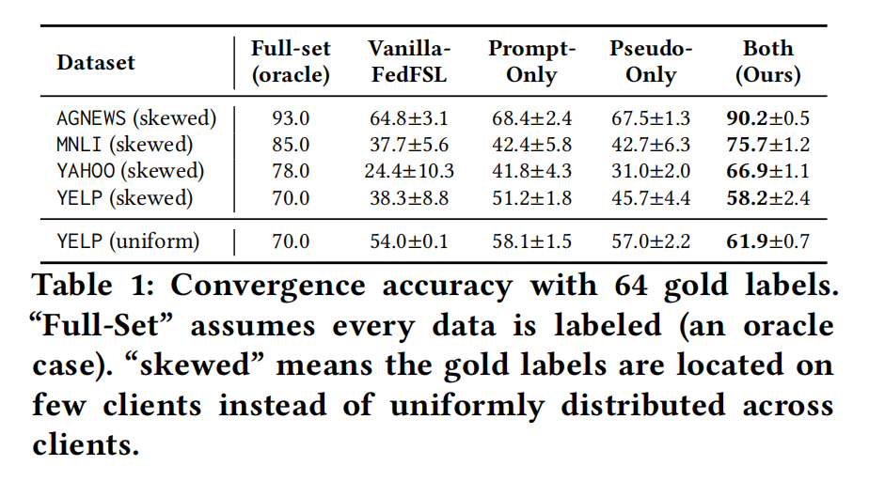
Ablation study of key components
Neither pseudo labeling nor prompt learning alone is enough to exhibit a usable accuracy

Slide 22
Prompt learning
See recent surveys on prompt learning [1-2] for more details.
[1]. Rishi Bommasani, Drew A Hudson, Ehsan Adeli, Russ Altman, Simran Arora, Sydney von Arx, Michael S Bernstein, Jeannette Bohg, Antoine Bosselut, Emma Brunskill, et al. On the opportunities and risks of foundation models. arXiv preprint arXiv:2108.07258, 2021.
[2]. Pengfei Liu, Weizhe Yuan, Jinlan Fu, Zhengbao Jiang, Hiroaki Hayashi, and Graham Neubig. Pre-train, prompt, and predict: A systematic survey of prompting methods in natural language processing. arXiv preprint arXiv:2107.13586, 2021.

Slide 23
Appendix
Figures from paper

